Slide 1
Team Ink3D Final Presentation
Daniel Lain
Tim Edmonson
Shawn Simonson
Jesse Bowles

Slide 2
Organization
Role | Assigned To | Responsibility
Project Manager | Daniel Lain | Maintain Project Plan Assign Tasks to Team Turn in Deliverables Risk Manager Change Approval
Hardware Lead | Shawn Simonson | Plan Hardware Interfaces Research Hardware Hardware Development ME Liaison Change Approval
Software Engineering Lead | Jesse Bowles | System Architecture Modular Planning Scalability Planning Develop UMLs Change Approval
Lead Programmer | Tim Edmonson | Algorithm Development Open Source Selection Algorithm Research Change Approval
Oversight – Dr. Shiakolas , Mr. O’Dell

Slide 3
Product Concept
Product: 3-D Printer Fabrication System
Problem Solved: The need to fabricate custom human compatible medical devices
Audience:
Dr. Panos S. Shiakolas, Manufacturing Automation and Robotic Systems (MARS) lab at University of Texas Arlington,
Medical Researchers
Material Researchers

Slide 4
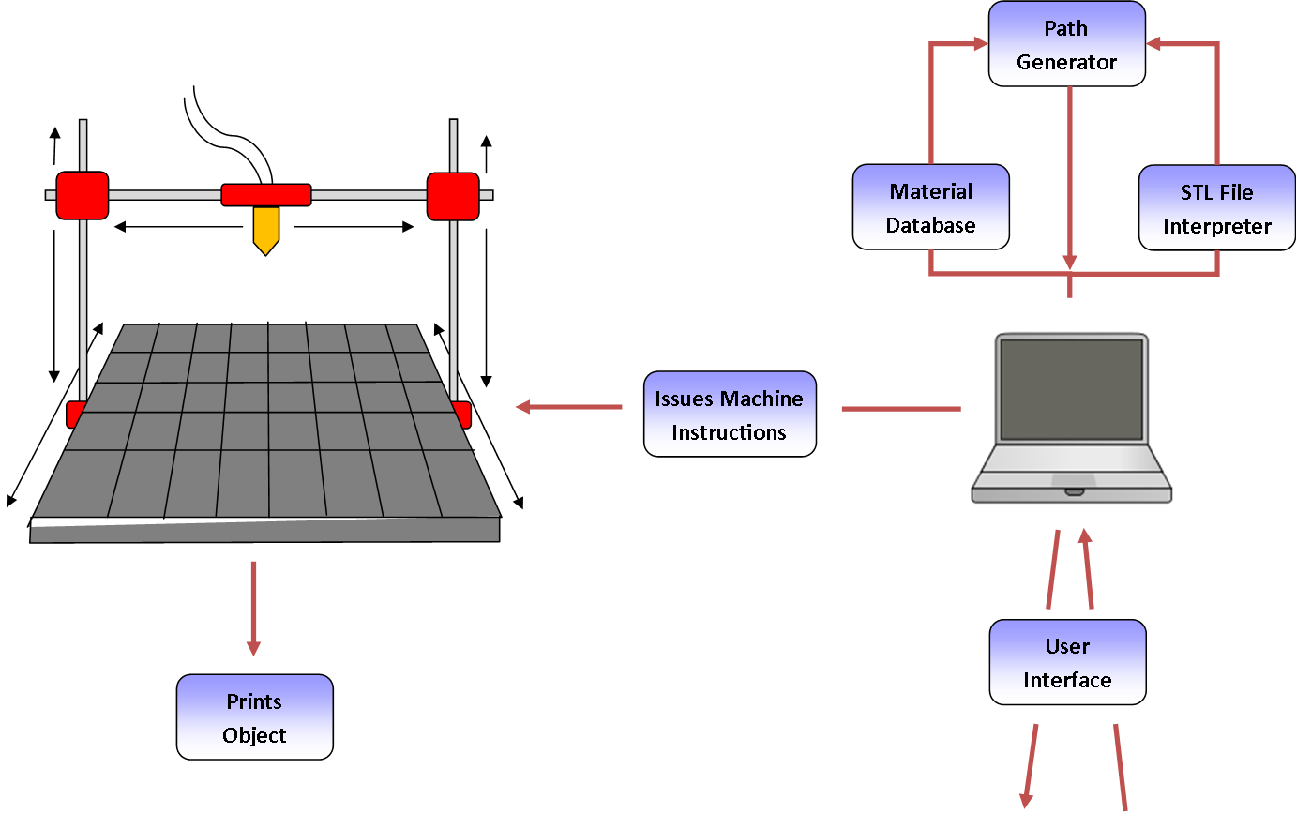
Product Concept

Slide 5
Functional Requirements
3.1 STL File Input
Priority: 1 – Critical
3.4 Issue Machine Instructions
Priority: 1 – Critical
3.5 Monitor Temperature
Priority: 1 – Critical
3.6 Monitor Position
Priority: 1 – Critical
3.8 Identify Materials
Priority: 1 - Critical
3.9 Identify Shapes
Priority: 1 - Critical
Completed
Partially Completed
Completed
Completed
Completed
Completed

Slide 6
Functional Requirements
3.10 Determine Shape of Support Material Structure
Priority: 1 - Critical
3.11 Create Printing Path
Priority: 1 – Critical
3.14 Slice Geometry into Thickness Levels
Priority: 1 – Critical
3.17 Allow for UV Head Polymerization
Priority: 1 – Critical
Non Critical Requirements
3.16 Monitor Door Switch
3.18 Sparsity and Density Controls
Completed
Completed
Completed
Completed
Incomplete
Completed

Slide 7
User Interfaces Requirements
3.2 Graphical User Interface
Priority: 3 – Moderate
3.12 Database Interface
Priority: 1 - Critical
3.13 Store & Load Material Records
Priority: 1 – Critical
3.19 Graphical Object Models
Priority: 5 – Future
Completed
Completed
Completed
Incomplete

Slide 8
Packaging Requirements
4.1 Software Installer
Priority: 1 – Critical
4.2 Host Software to Printer Connection
Priority: 1 – Critical
4.3 User Manual
Priority: 3 - Moderate
Completed
Completed
Completed

Slide 9
Performance Requirements
5.1 Startup Time
Priority: 4 – Low
5.2 STL Import Time
Priority: 4 – Low
5.3 Object Processing Time
Priority: 2 – High
5.4 GUI Responsiveness
Priority: 3 – Moderate
5.5 Real Time Sensor Monitoring
Priority: 2 – High
Completed
Completed
Completed
Completed
Completed

Slide 10
Other Requirements
6.1 Temperature Cutoff Threshold
Priority: 1 – Critical
6.2 Printing Area Restrictions
Priority: 1 – Critical
7.1 Host Software Manual
Priority: 1 – Critical
7.2 Source Code Documentation
Priority: 2 – High
7.3 Source Code Availability
Priority: 2 – High
8.1 Material Database
Priority: 1 – Critical
8.2 Abstract Hardware Interface
Priority: 1 – Critical
8.3 Modular and Scalable Design
Priority: 1 – Critical
Completed
Completed
Completed
Completed
Completed
Completed
Completed
Completed

